Slide 1
Securing Windows
John Johnson

Slide 2
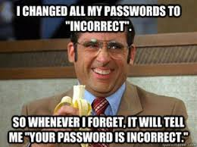
User Accounts
Change all passwords
for /f "tokens=* skip=1" %%a in ('wmic UserAccount where "LocalAccount=True" get Name') do (
if not "%%a"=="" (
net user %%a [password]
)
)
Use on screen keyboard instead of physical keyboard for password
Change Administrator password

Slide 3
System Hardening
OS updates
Windows Flag->Control Panel->Windows Update
UAC turned to highest setting
Windows Flag->Control Panel->User Accounts

Slide 4
Finding Malware
Connections
Processes
Files
Scheduled Tasks
Registry
New users

Slide 5
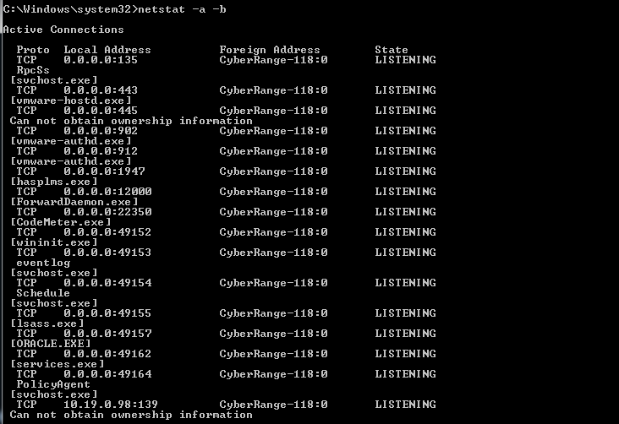
Open Connections
Netstat
netstat
–a
(–o to get process)
(-f [protocol])
(-b to get executable)

Slide 6
Open Connections Cont.
Local Address
Look for ports on your machine
Need to correspond to services you are running
You are not running a service on port 1337
Remote Address
Is address on local network (192.168.X.X)
If it is not, write down address and put it on board

Slide 7
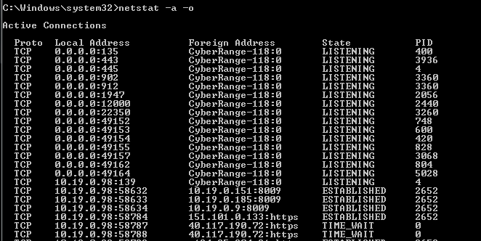
Open Connection Example
Ports?
TIME_WAIT?

Slide 8
Processes/Executables
Windows Flag->type in task manager
Linked to connections
Delete executable
wmic process get ProcessID,ExecutablePath
Write name down
Powershell
Good if you are running it, bad if you aren’t, disastrous if you don’t see it
WMIC
Administrator Tool similar to powershell

Slide 9
Executables Cont.
tasklist
tasklist | find [pid]
Misspelled processes
explorer.exe->explore.exe
csrss.exe
services.exe->service.exe
svchost.exe->scvhost.exe
spoolsv.exe

Slide 10
Executables Cont.
taskkill /PID 2704 /F
Outdated services can be exploited
Stop them from running
Leave them available in case of inject

Slide 11
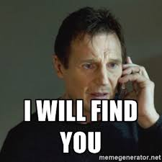
Filesystem
Check tmp folder
echo %temp%
exist for all accounts

Slide 12
Scheduled Tasks
task scheduler (it’s a GUI)
Windows Flag->type in task scheduler
Look at active tasks
command line
schtasks /query

Slide 13
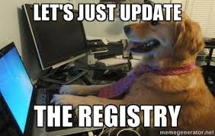
Registry
Win + R
msconfig
compmgmt.msc
secpol.msc (lockout)
optionalfeatures
appwiz.cpl
services.msc
control folders

Slide 14
New Users
Create original list
net user > user.txt
Continually create new list and diff
net user > user2.txt
FC user.txt user2.txt

Slide 15
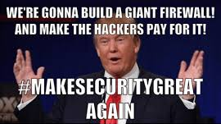
Firewall
Make sure it’s on
Whitelist rdp (to/from) our host machines
1 port, several IPs
Whitelist list of services (to/from)
Everything else should be closed

Slide 16
Services
May have passwords of their own
mysql
Configuration Files
Vulnerabilities

Slide 17
Continuous actions
Firewall
Malware
Users
Services

Slide 18
Finding Malware Initially
Get rid of it
Write down the incident
Blacklist necessary IPs

Slide 19
Finding Malware After Hardening
Get rid of it
Write down the incident
Change all passwords again
Figure out how they got in
Blacklist necessary IPs

